Slide 1
Revenue Success rate of Relay kart
A company named Relay kart (start-up company) has been selling computer hardware in united states they want to know the revenue status of their company so they came up to reviewing the products from customer to get a review about their products and customer service so that they can improve more and get a good relationship with the customer and increase their revenue if its low or average . the task is to calculate the revenue over time , revenue made from each region and to forecast the revenue in the upcoming years using the previous year’s data.

Slide 2
Objective
Relaykart has started selling products in different region of united states since they are a start-up company they want to how much revenue they are getting overall through each region, and the upcoming revenue over years so we need analyse the revenue they are getting by selling their products so the task is to analyse the revenue and visualise them to the company for better understanding

Slide 3
Process
Data collection
Data preparation
Data analysis
Data visualization

Slide 4
Problem statement
Find the Revenue by Region
find the delivery performance whether its delayed or on time
Return rate of products by customer
customer acquisition type
customer satisfaction
price variation over the years
revenue over time
revenue of products over years
high and least purchased product over years

Slide 5
Data description
Customer Acquisition Type : refers to bringing in new customers or convincing people to buy your products.
state : region where your product is sold or bought
product : types of product you are selling
price : price range of each product
units : quantity of products sold
revenue : income earned from the sales (Total Revenue = Quantity Sold x Price)
delivery performance : it is performance measured by delivering the products at quality , speed of delivery etc.
return : returning of product from customers
customer satisfaction : mainly important because customer rates the quality of the product the way its delivered

Slide 6
Visualization

Slide 7


Slide 10
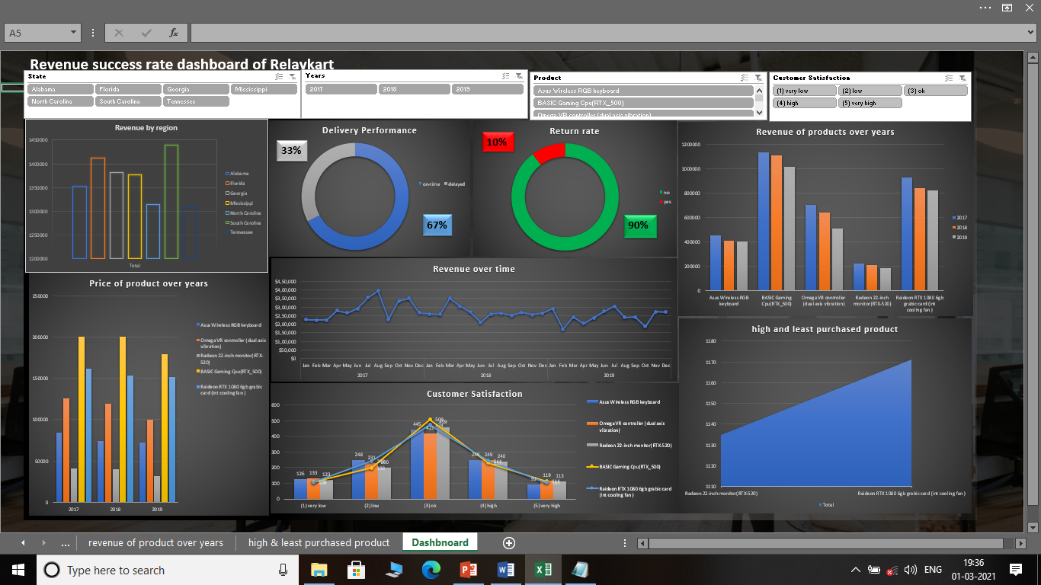
Dashboard

Slide 11
Conclusion
As we can see through the visualization is that the forecast revenue coming into the company is stable and average so we have to mainly focus on the quality of products and maximise the customer satisfaction so that for upcoming revenue income can be maximised.

Slide 12
Tools / Skills Used
Ms Excel
Tableau
Data visualization
Data analysis

